Slide 1
WAD2: Project E-Health
By Calum Young, Alex Marshall, Nikolay Ivanov and Carly Crawford

Slide 2
The Problem
The internet contains so much information. So many pages dedicated to multiple topics. Sometimes it can be downright confusing.

Slide 3
The Problem
Healthcare, in particular, has a lot of conflicting information.
Some of it might be genuinely good advice.
Other people might be trying to sell you a product or have another agenda.
Others might just be downright wrong and their information has no credibility.

Slide 4
The Problem
Other times, the information can stir up a lot of fear in the general population.
For example, a sore head can be caused by a multitude of reasons.
One being a cold/flu.
The other being carbon monoxide poisoning.
Which one is more likely?

Slide 5
E-Health
This is where E-Health comes in.

Slide 6
E-Health
E-Health essentially provides a way for people to search for symptoms and illnesses.
A list of results will be returned from different sources.
Mainly pages from US website healthfinder.gov, MedlinePlus and other results from the world wide web.
The user can choose to see pages from a combination of these sources or just from a single source.

Slide 7
E-Health
The user can see where the result has came from (ie Medline Plus, HealthFinder etc)
The page is analysed in many different ways:
Readability
If the page gives of a happy or sad vibe
How likely the illness is

Slide 8
E-Health
The user can also create a profile.
Once he/she has done so, they can create categories and add pages to them.
For example, they can create a Diabetes category and add all the pages providing useful information to it.
These are hidden to all but the user.
The user can share pages or categories via Google+, Facebook or Twitter

Slide 9
E-Health
But who would be the typical users of E-Health?

Slide 10

User Persona 1 - Laura
Name – Laura Smith
Age – 24
This is Laura. Laura is a young woman who has been experiencing symptoms such as headaches, blocked sinuses and a sore throat. She would like to know what illness she has and whether she needs to see a doctor or not.

Slide 11
E-Health and Laura
Using e-Health, Laura would be able to input her symptoms and the app will return a list of possible illnesses, in order of most likely to least likely. E-Health will also suggest ways to treat the illness and suggest she contact her doctor, if necessary.

Slide 12

User Persona 2 - Dave
Name – Dave Jones
Age – 63
This is Dave. Dave is a diabetic and would like some easy access to articles containing information and advice on his condition. Dave is not very technologically adept, so any websites or apps he uses have to be simple and easy to follow. He would also like to be able to save any articles he finds so they are easier to find later.

Slide 13
E-Health and Dave
Using e-Health, Dave will be able to look up his condition and find helpful advice and information. E-Health has a very simple and easy-to-follow layout, so Dave will be able to navigate the site with little to no problems. If he creates an account, Dave will also be able to save the results of his searches in order to easily access them later.

Slide 14
What will the system look like?
The system architecture will look like the following:

Slide 15
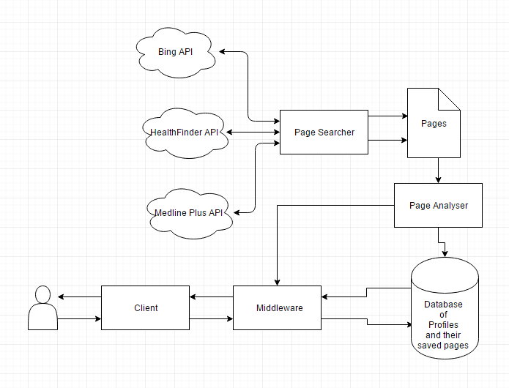
System Architecture
This is the system architecture:
It makes use of three APIs and our page searcher algorithm and creates a combination of results depending on what API the user wants to use.
Once we have the results. All the pages are put through an algorithm that analyses the pages for their sentimentality value, readability value.
If the page is saved by a user it is put into their saved pages field.

Slide 16
The Database
The database will contain entries for all user profiles and each user profile will have their own list of categories and within those categories are pages.
The ER diagram gives a good visualisation of this.

Slide 17
ER Diagram

Slide 18
What will the client see?
The client is in need of a user friendly interface that is easy to use which causes minimum confusion.
The client will see the following:

Slide 19
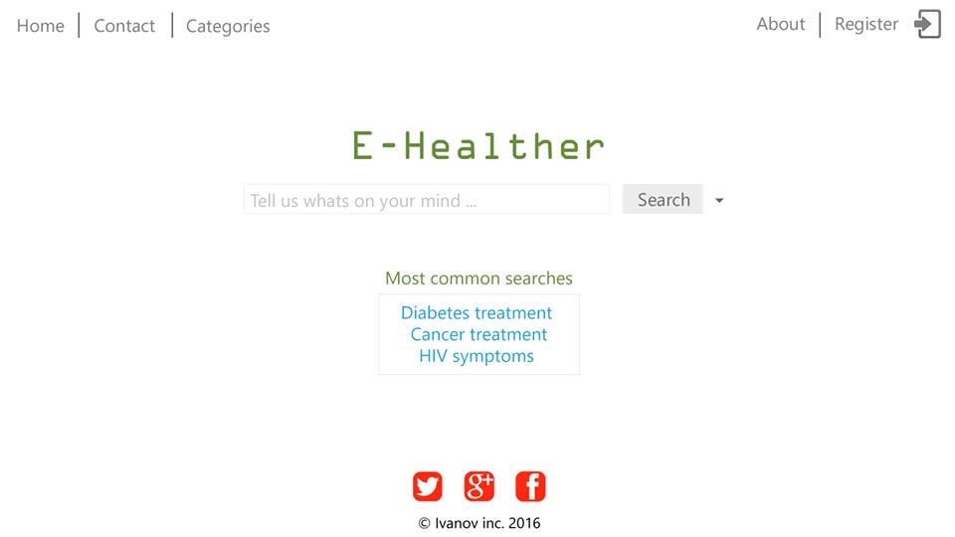
Wireframes – Main Page

Slide 20
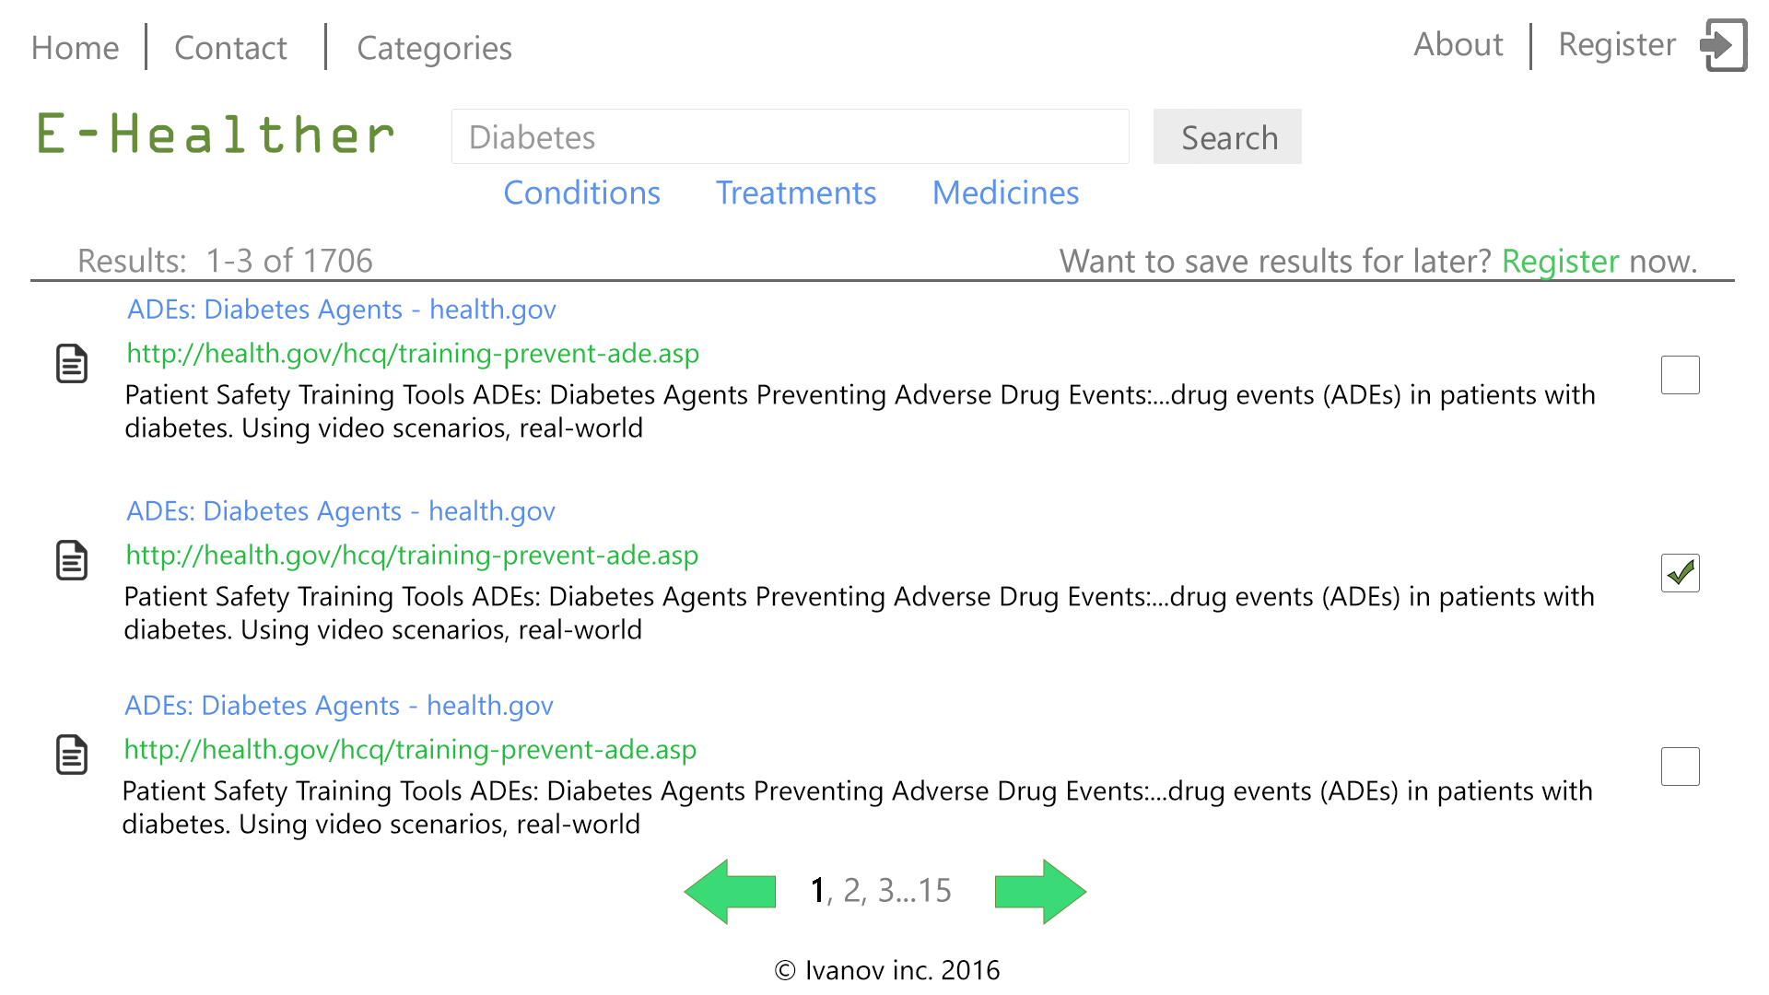
Wireframes – Main Screen after search

Slide 21
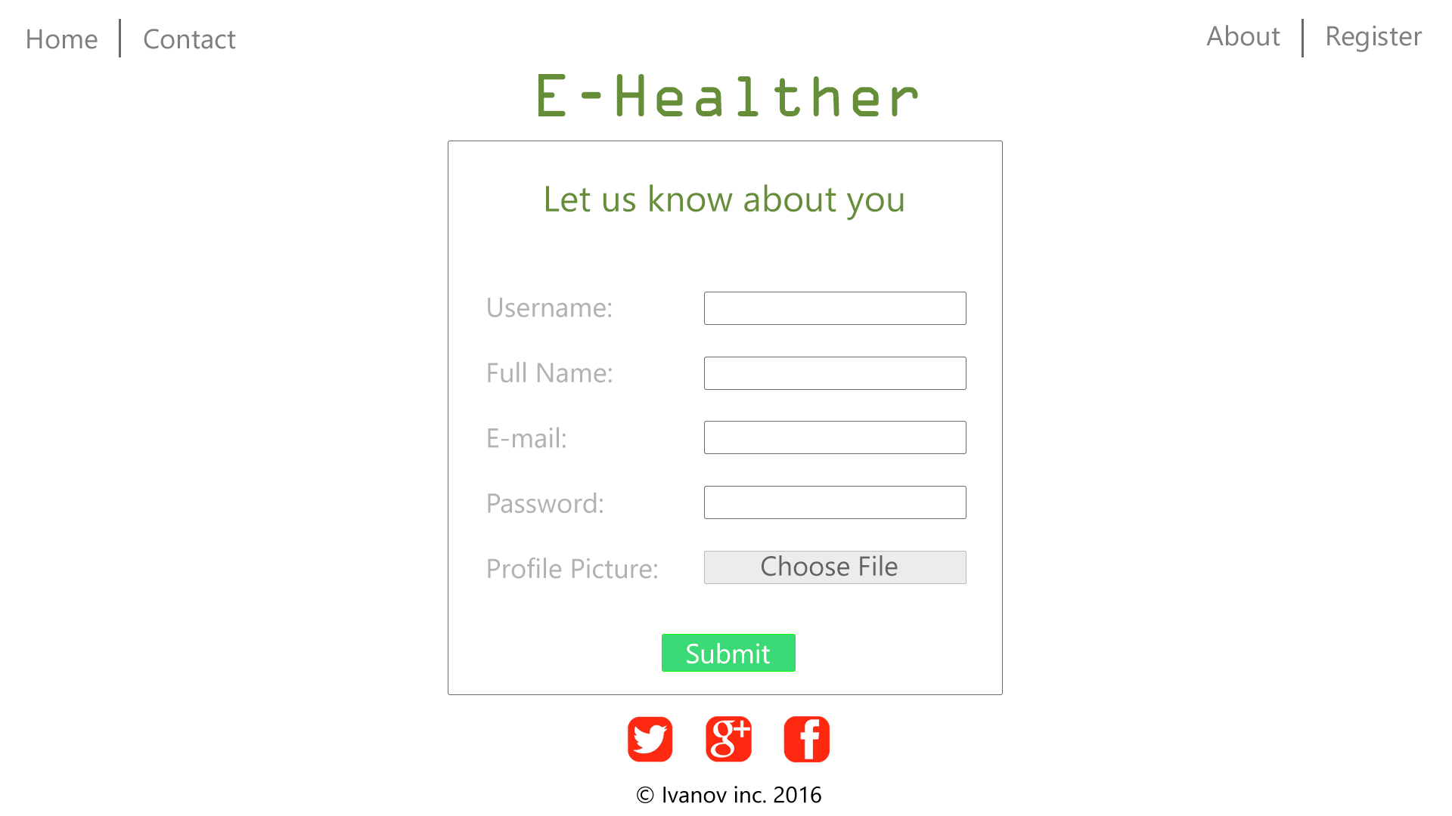
Wireframes - Register

Slide 22
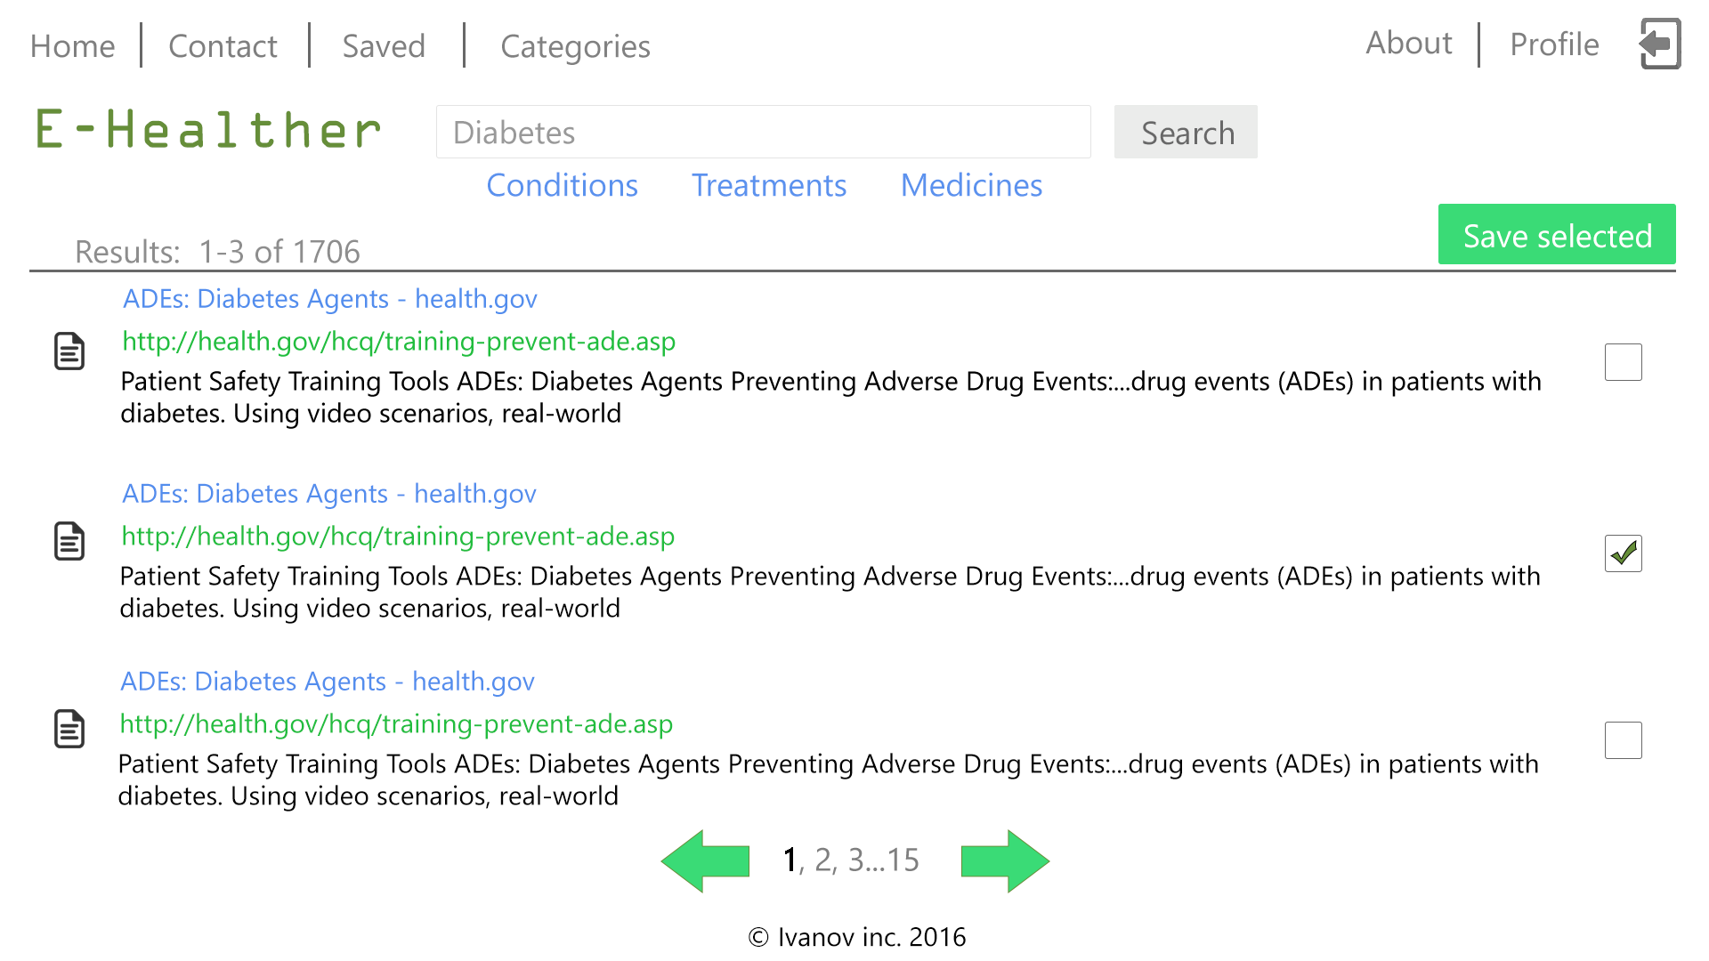
Wireframes – Main Page After Log In

Slide 23
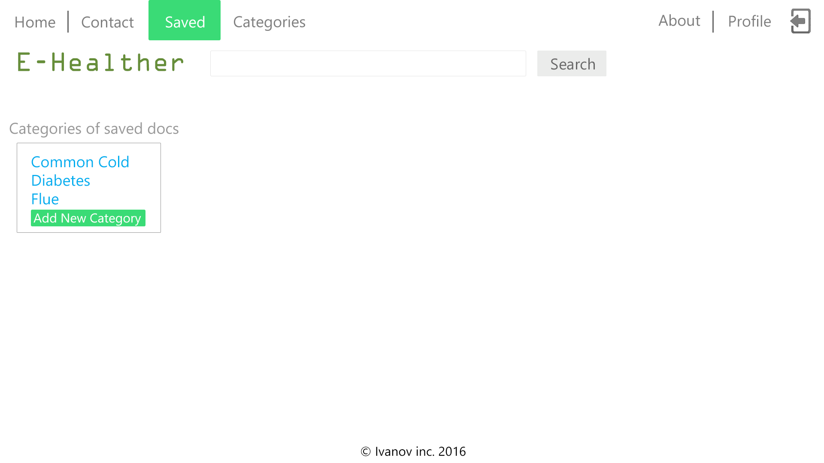
Wireframes – Save Page Screen

Slide 24
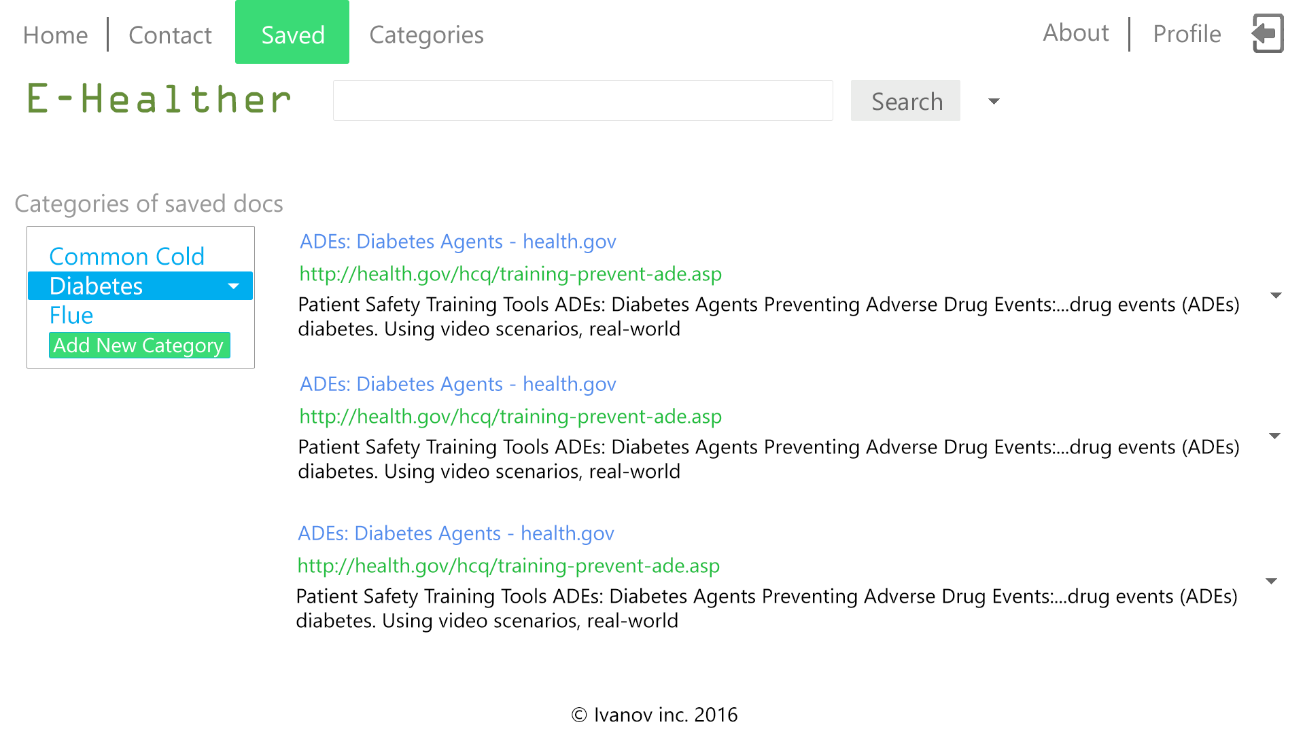
Wireframes – Save Page Screen

Slide 25
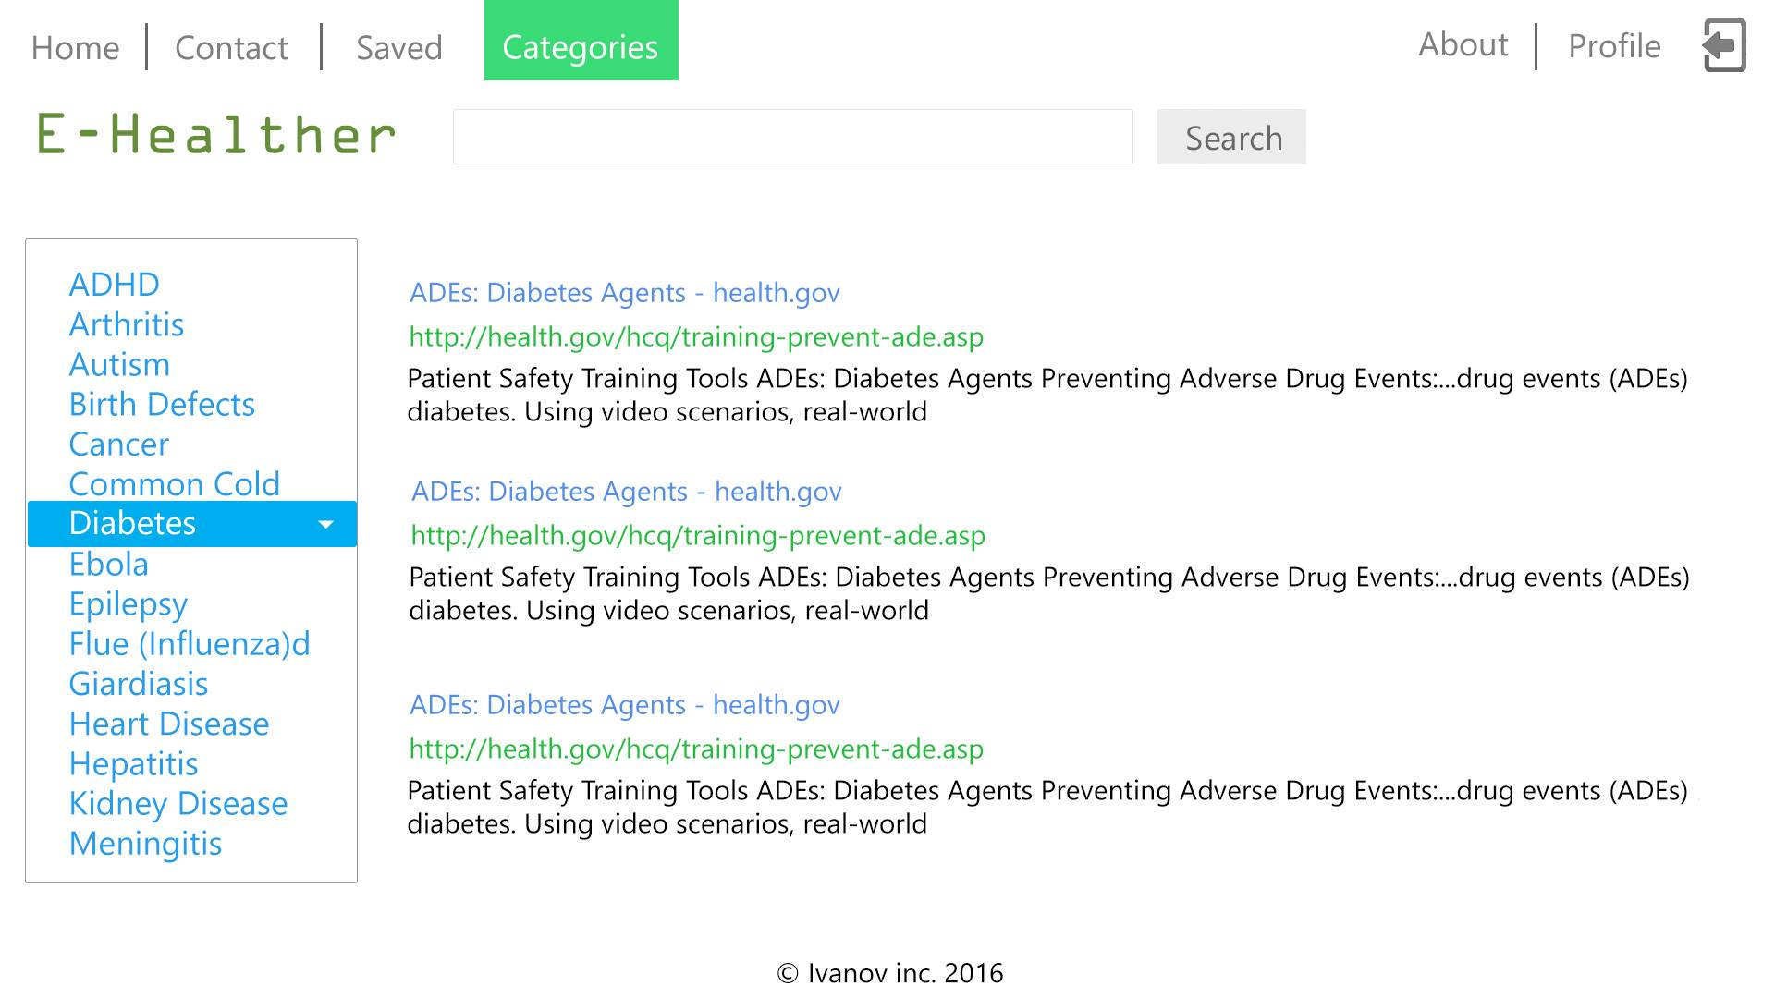
Wireframes – Categories Page

Slide 26
And That’s e-Health!
Hope we’ve gave a good overview of what our application will look like and how it will act.

